Slide 1
Executive Presentation

Slide 2
Agenda
Mission & background
Hallmarks of a good charity
How do we measure up?
Want to help change someone’s life?
Outlook

Slide 3
Mission and Background
Pathways to Independence commits to catalyzing profound and productive changes in the lives of young women in Long Beach and Orange County who have been abused by their families and neglected by society.
300+ young women have entered the program. 80% successfully graduate.
Heal trauma from dysfunctional families & provide a college education.
Leverage what’s right with the world:
  19 volunteer board members, 300+ volunteers & thousands of donors
  Full payment for the costs of tuition & books
  Monthly rent stipend
  Mentoring and free counseling, access to medical care, dental care, etc.

Slide 4
Mission and Background
50+ young women currently in the program:
  Poor by federal/state standards.
  Many come from alcoholic families.
  Have experienced abuse ranging from incest to violence.
  Some spent years in foster care or became indigent.

Slide 5
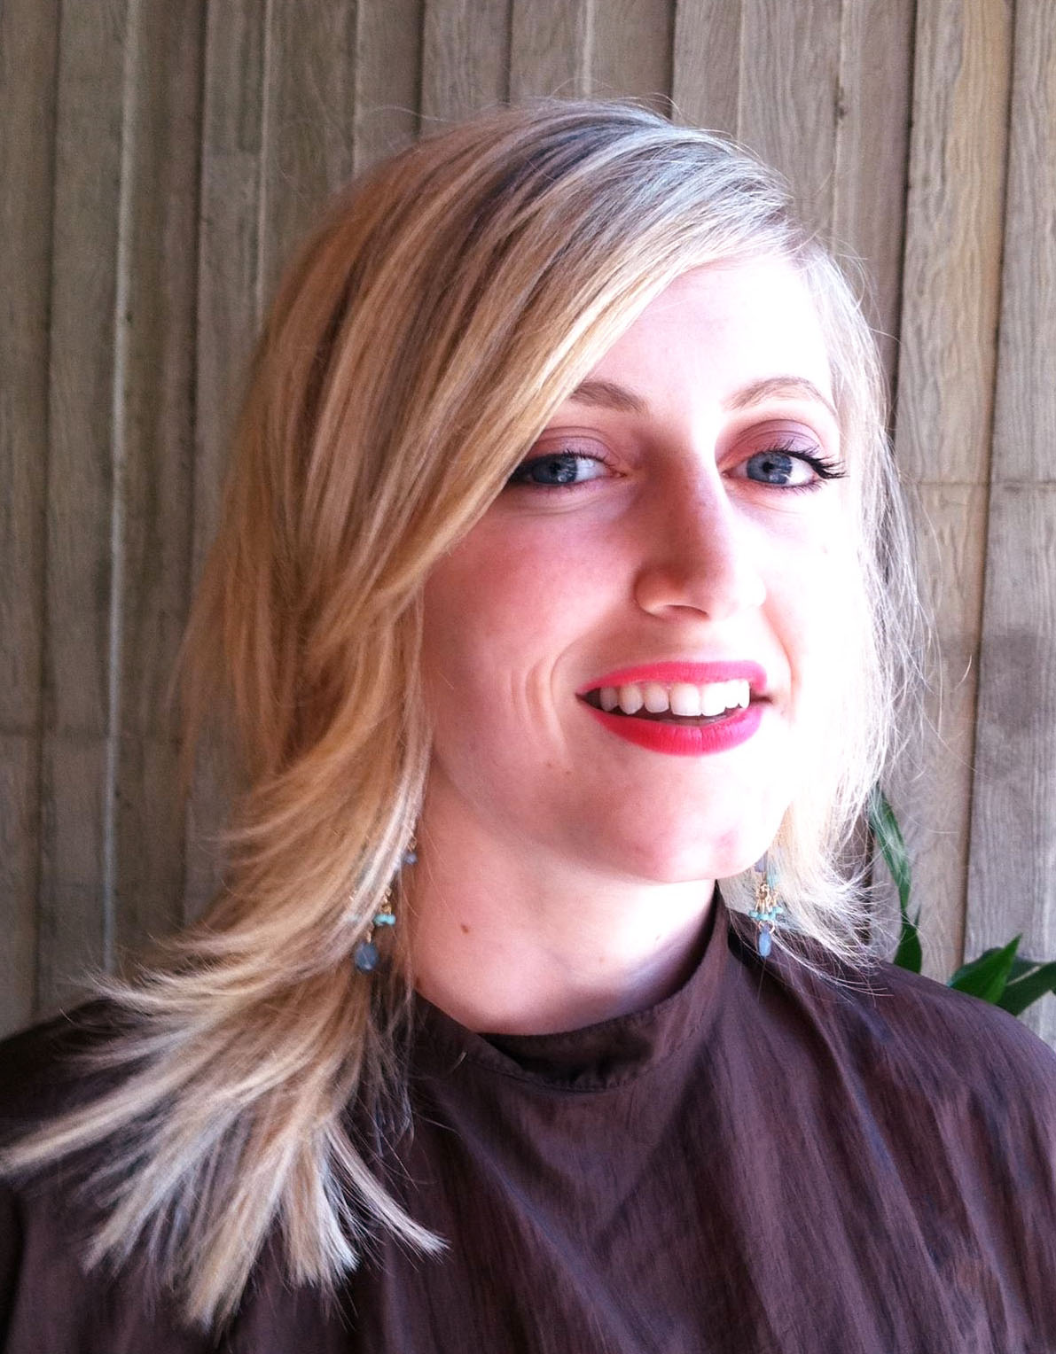
Meet Janica
Janica was the fourth in a family of ten children with an extremely controlling father who was mentally and physically abusive. She was home schooled until the fourth grade and he would not allow his children to play with other children. Janica had the responsibility of caring for each infant born to her parents as soon as her mother returned to work.
After her parents divorced, the children were placed in foster care when it was discovered that they were often left home to care for each other while she worked. While at Orangewood Children’s Home it was determined that she and her sister had been molested.
She began abusing drugs and alcohol and at the age of 14.
Janica decided it was time to turn her life around. She quit drinking and getting high 4 years ago and applied to Pathways because she really wanted an education and a career, but had no means to pay for college.
She is currently attending college at Cal State Fullerton as a business major and is maintaining a 3.95 GPA.

Slide 6
Hallmarks of a Good Charity:
Community Impact
Efficiency
Financial Strength & Stability
Active Board of Directors

Slide 7
How Do We Measure Up?
Community Impact:
Helping those who expect it the least, and need it the most.
  80% graduation rate. 300+ clients served.
  Many of the graduates pursue professions that greatly benefit society (teaching, social work, etc.)
  Engaging 300+ volunteers from the local community.
  Many professionals in the 40-60 year age range crave an opportunity to use their gifts for the greater good.

Slide 8
How Do We Measure Up?
Efficiency:
 | Efficiency (Program Expense Ratio) | 2013 CEO Compensation | FY 2013 Revenue
Big Brothers Big Sisters of Orange County | 81.1% | $169,535 | $2,800,672
Orange County Rescue Mission | 78.2% | $285,335 | $11,989,864
United Way of Orange County | 82.9% | $240,629 | $17,701,165
Pathways to Independence (2013) | 87.1% | $0 | $2,441,186
*Program Expense Ratio = Program Expenses / Total Expenses
*Source: Charity Navigator

Slide 9
How Do We Measure Up?
Financial Strength & Stability:

Slide 10
How Do We Measure Up?
Financial Strength & Stability:
  Ongoing commitments from two large family foundations.
  Winning new grant awards.
  Continued growth in Fundraising Revenue.

Slide 11
How Do We Measure Up?
Financial Strength & Stability:
  Strong Balance Sheet with 9% of Assets in Cash and virtually no Liabilities.
  2014 Liabilities (accounts payable) as a % of Total Assets < 1%.
  Pathways has paid off one apartment building and is nearing paying off a second
  building to house 34 clients
  Multi-million dollar gift enabled acquisition and development of an apartment complex that now houses 16 clients.

Slide 12
How Do We Measure Up?
Pathways to Financial Independence
What it will mean when Pathways to Independence pays off the new building:
Prior Housing Cost Without PTI Buildings (50 Clients @ $650 Monthly Rent Stipend) | $390,000
Housing Cost With PTI Buildings Paid Off and Occupied by Clients (18 Clients @ $650 Per Month + $65,000 Dunbar Expenses) | $205,400
Ongoing Annual Savings In Client Housing | $184,600 +

Slide 13
How Do We Measure Up?
Active Board Members:
 | 2003 | 2004 | 2005 | 2006 | 2007 | 2008 | 2009 | 2010 | 2011 | 2012 | 2013 | 2014
Board Members | 12 | 12 | 12 | 14 | 15 | 16 | 16 | 16 | 16 | 16 | 17 | 19
Board Members who were Past Clients | 2 | 3 | 3 | 4 | 4 | 4 | 4 | 4 | 4 | 5 | 5 | 5

Slide 14
Want to help change someone’s life?
DONATE
  With 50+ young women enrolled, we still have 50+ on the waitlist.
  Our primary constraint is funding. Every dollar matters!
VOLUNTEER
  Donate your skills as a professional. Join 40+ doctors, 47+ licensed
  therapists, 20+ dentists and orthodontists, etc. and forever change
  a young woman’s life.
MENTOR
  Feel good every week by interacting with a young woman in need
  of guidance, support, and love.
When you give, you receive.

Slide 15
Outlook:
Demand vastly exceeds Supply.
  50+ clients in the program and 50+ on the waitlist,
  and we’ve never advertised.
Primary growth constraints are funding & human capital.
  Hired part-time fund developer to increase success of annual fundraiser.
  Pursuit of grants and gifts from foundations by volunteer grant writer.
  Creating subsidiary management teams to increase capacity.

Slide 16
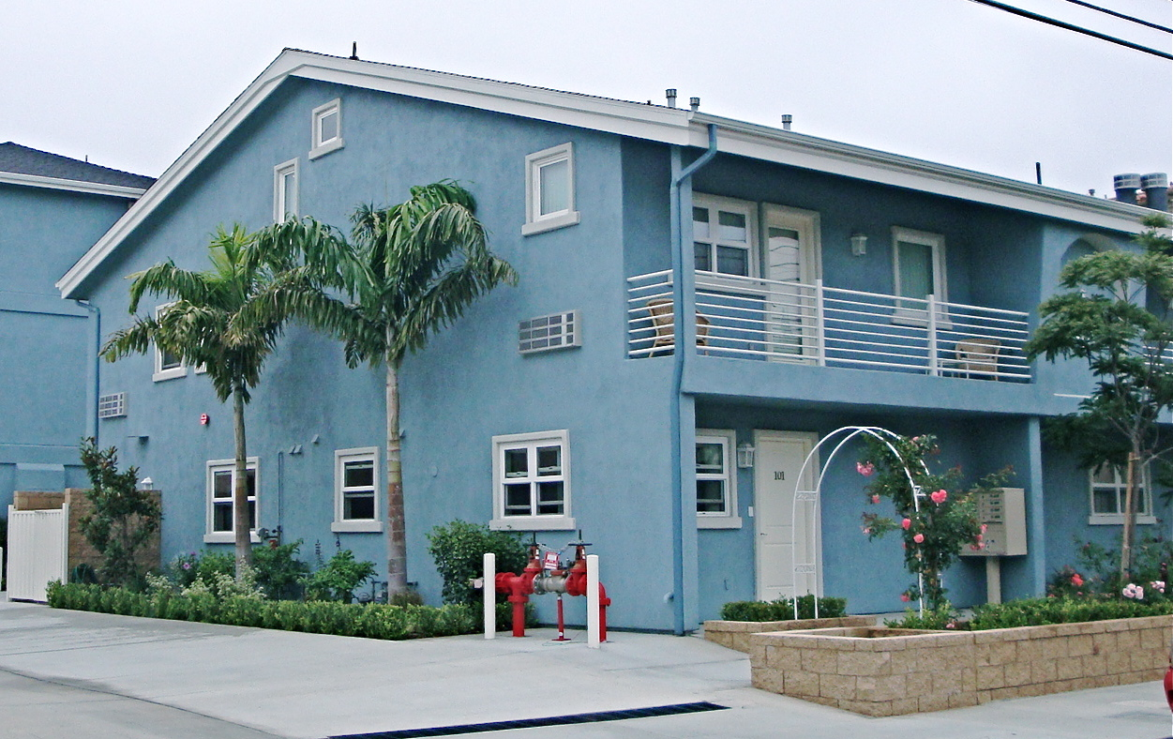
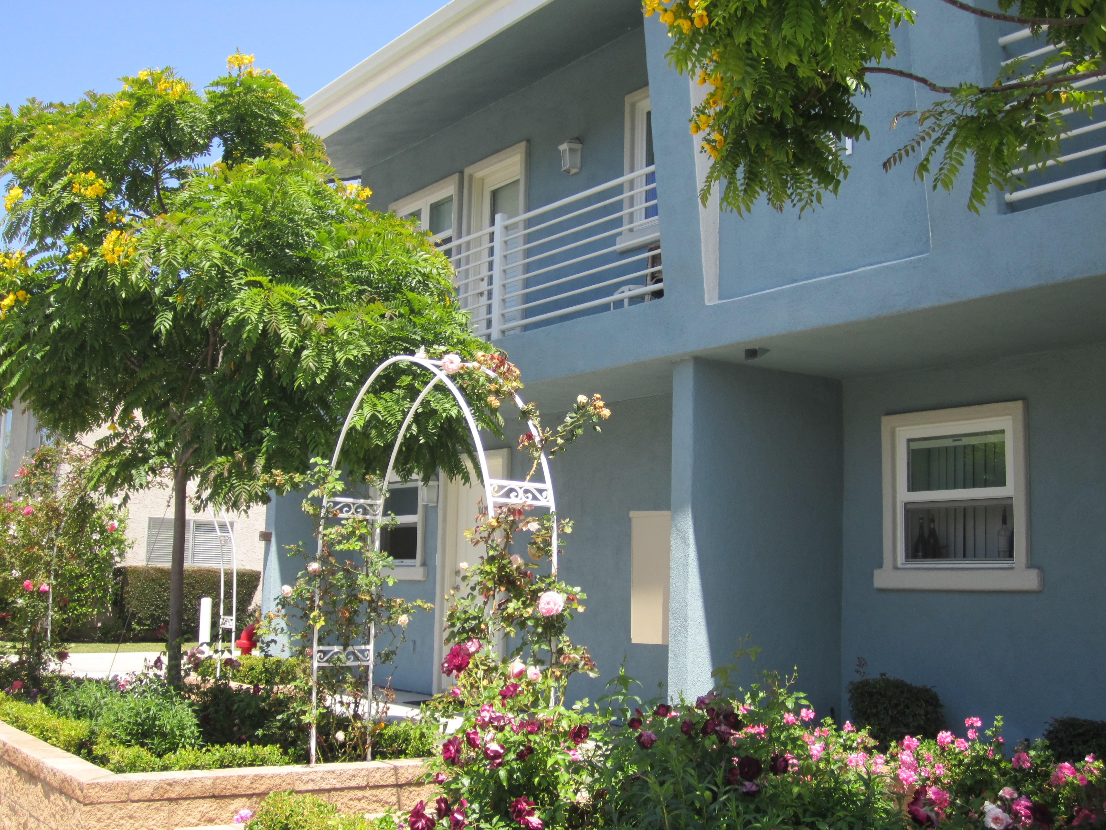
Huntington Beach, CA
Thanks to the Bickerstaff Family Foundation, 16 of our clients
live in this beautifully remodeled complex!
The common living area increases the sense of community
and makes clients more accountable.

Slide 17
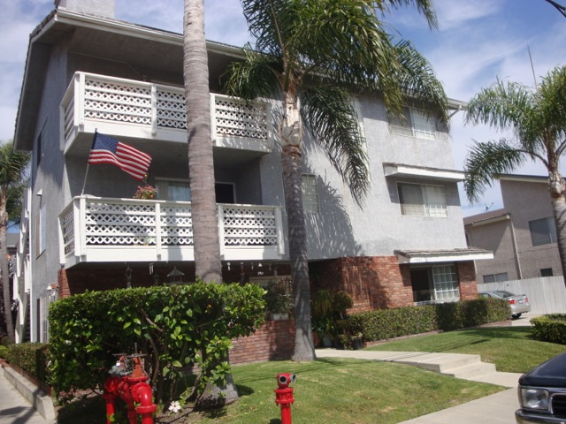
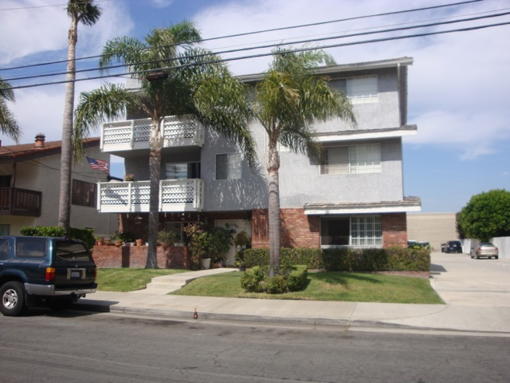
Huntington Beach, CA
Purchased in 2011 for $1.8 Million.
Projected to owe less than $250,000 by December 2015, at
which point 18 clients will be living in the residence.
Living together increases the sense of community and makes
clients more accountable.

Slide 18
Pathways Officers
No Officers or Board Members receive any compensation whatsoever.
David Bishop
President
Larry Beaver
Chief Financial Officer
Peggy Dawson
Mentor Coordinator
Dr. Jeff Barke
Medical Director
David Davies
Treasurer
Dave Wagner
Treasurer
Caren Stout
Treasurer
Dave Wagner
Treasurer
Patsi Wagner
Secretary/Director/Mentor Coordinator
Renee Banchiere Program Director
Erin Butler
Program Director
Jennifer Mahoney Program Director
Peggy Wolters
Mentor Coordinator
Mark Zurieck
Mentor Coordinator
Susie Gowin
Mentor Coordinator
Suzanne Houlihan
Mentor Coordinator
Tracey Hutton
Mentor Coordinator
Peggy Neslage
Mentor Coordinator
Angelica Sanchez
Mentor Coordinator
Tracy Sounders
Mentor Coordinator

Slide 19
Pathways Board of Directors
No Officers or Board Members receive any compensation whatsoever.
David Bishop, President
Retired High School Principal
Huntington Beach
Carol McAllister
Retired Elementary School Principal
Huntington Beach
Larry Beaver
Retired Principal
Cypress
Lisa Fluke
Executive Legal Assistant
Huntington Beach
Patsi Wagner
Retired, Pastoral Associate
Fountain Valley
Jeff Barke, M.D.
Physician
Los Alamitos
Diana Hill
Businesswoman
Los Alamitos
Sharon Dickson, MSW, LCSW
Therapist
Santa Ana
Peggy Dawson
Retired High School Principal
Huntington Beach
Nikki Harris, MA, LMFT
Therapist
Huntington Beach
Susan Gowin
Community Volunteer & Educator
Seal Beach
Denise Hendler
Administrator, US Bank
San Clemente
Angelica Sanchez*
Businesswoman
Long Beach
Seana Cormack*
Program Director OCSPCA
Huntington Beach
Kitty Barlow
Accountant
Huntington Beach
John Bishop
Community Volunteer & Student
Santa Ana
Aileen Cruz*
Human Resource Administrator
Long Beach
Erin Grasmeyer*, MA, MFT
Therapist
Los Alamitos
Wil Drouin
Property Manager
Tustin
*Pathways Graduate

